Slide 1
Understanding Machine Learning algorithms PESUIO_Slot-14
Natural Language Processing with Disaster Tweets

Slide 2
What is NLP?
Natural language processing (NLP) refers to the branch of computer science concerned with giving computers the ability to understand text and spoken words in much the same way human beings can.

Slide 3
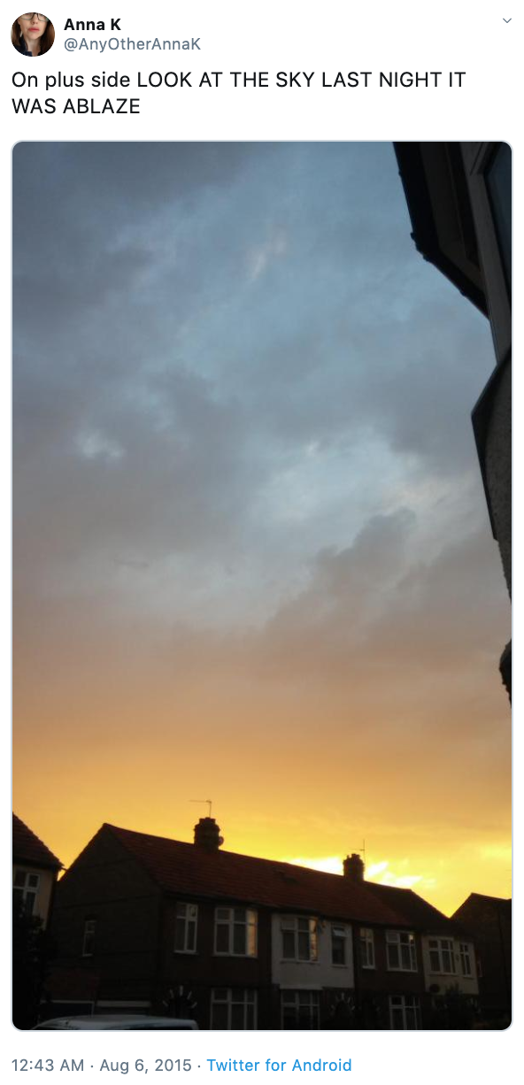
The author explicitly uses the word “ABLAZE” but means it metaphorically. This is clear to a human right away, especially with the visual aid. But it’s less clear to a machine.
Tweet source: https://twitter.com/AnyOtherAnnaK/status/629195955506708480

Slide 4
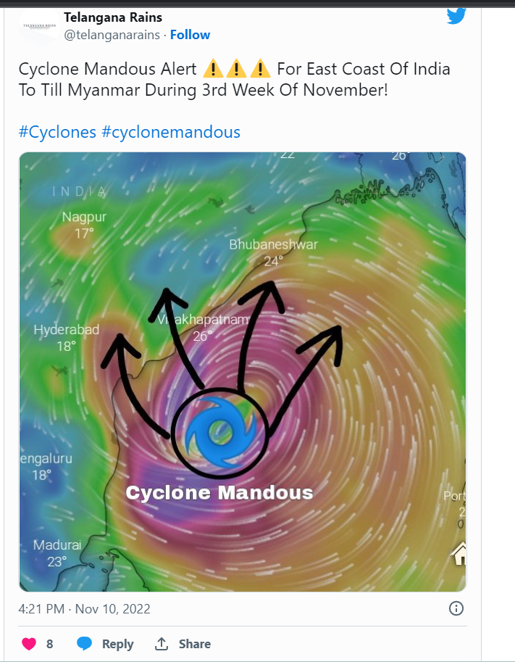
An actual cyclone alert, notifying of a potential disaster!

Slide 5
Method used
So here we have used TfidfVectorizer. So what is TF-IDF?
Term frequency-inverse document frequency is a well known method to evaluate how important is a word in a document.

Slide 6
Model Results Classifier
Support Vector Machines
Decision Tree
Random Forest
Accuracy= 80.5 %
Accuracy=73.5%
Accuracy=79%
Logistic Regression
Accuracy= 80 %

Slide 7
Improvements
The prediction accuracy could be improved by feeding it to a neural network using PyTorch,ELECTRA BASE etc..

Slide 8
Thank You

